Slide 1

Vuforia Engine Technical Presentation
Binh Nguyen
IOT Presales
PTC FY2021
Notes:
Hello –

Slide 2
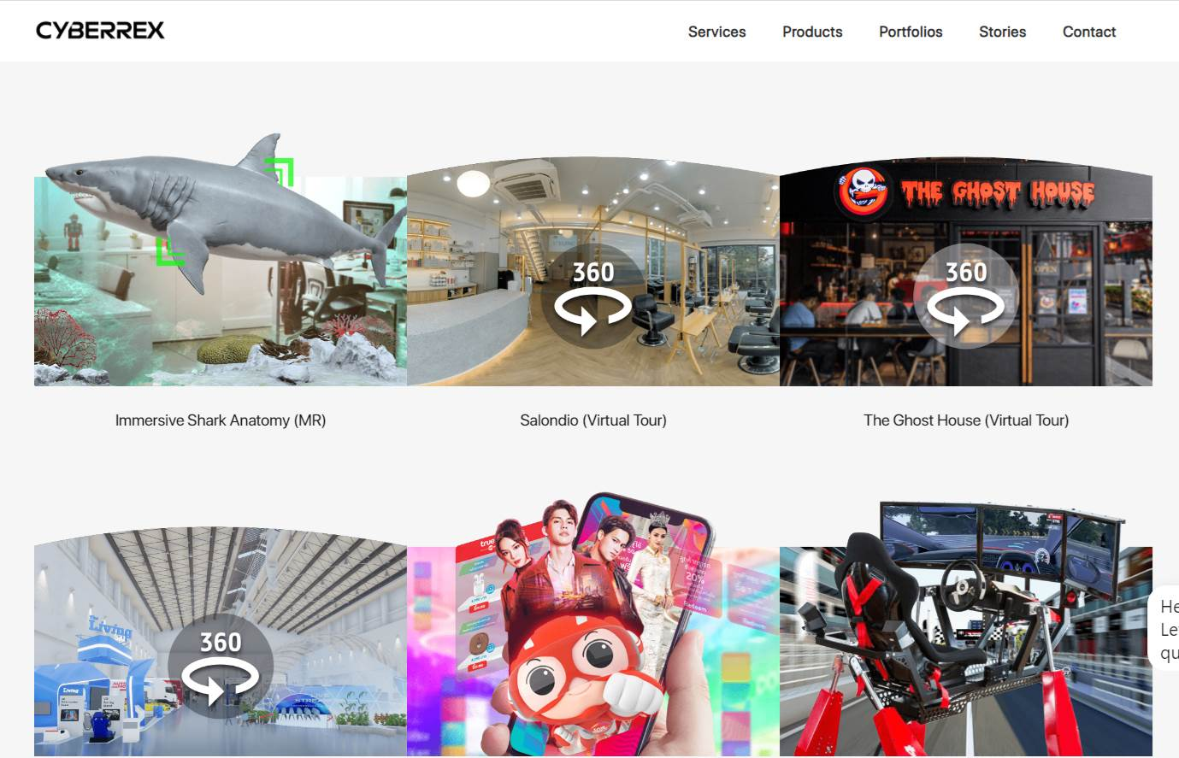
https://www.cyberrexdesign.com/Portfolios/

Slide 3

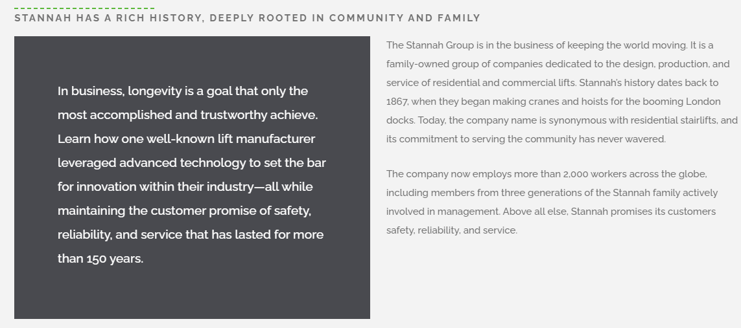
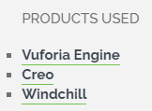
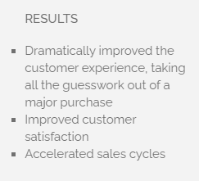
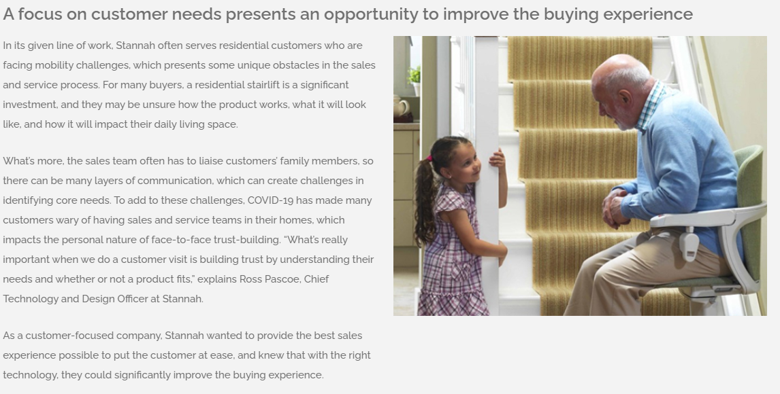

Slide 4

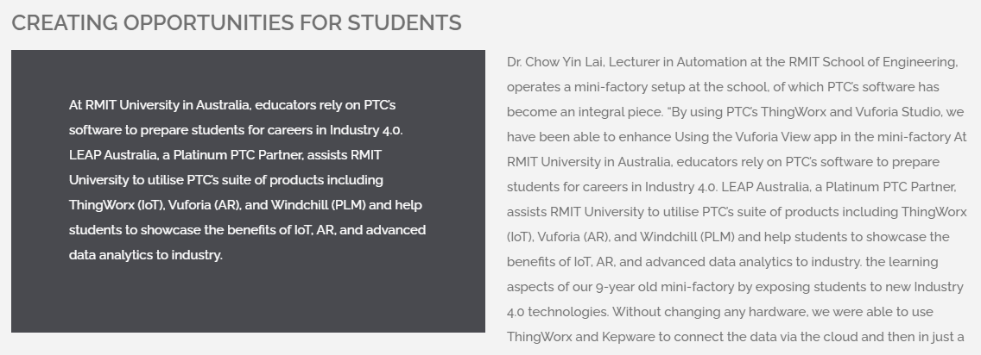
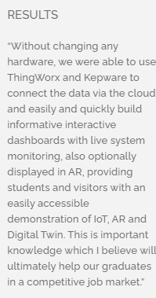
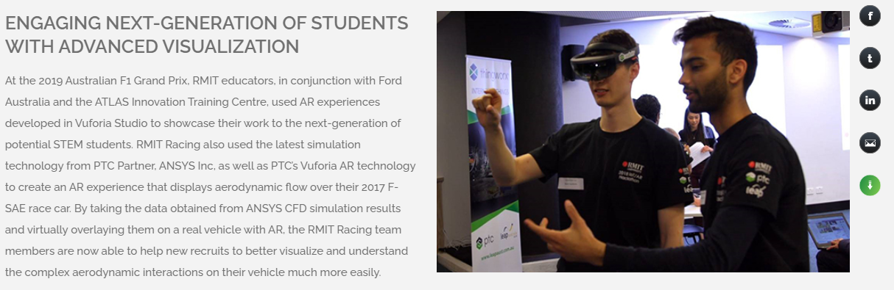

Slide 5

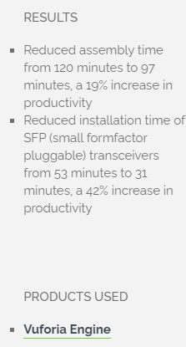
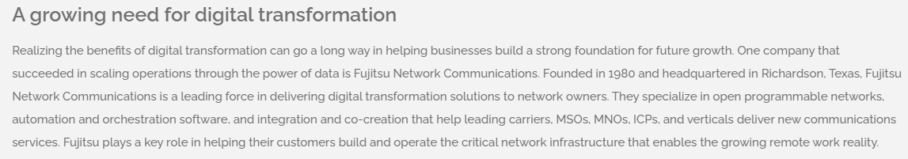
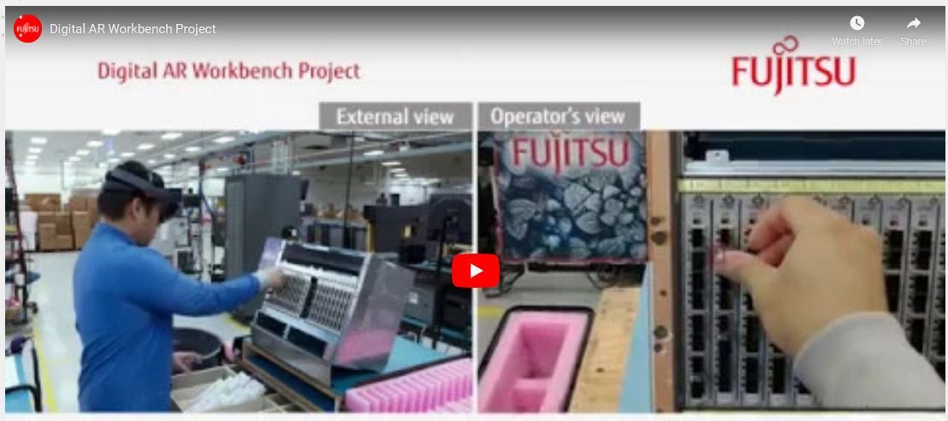

Slide 6

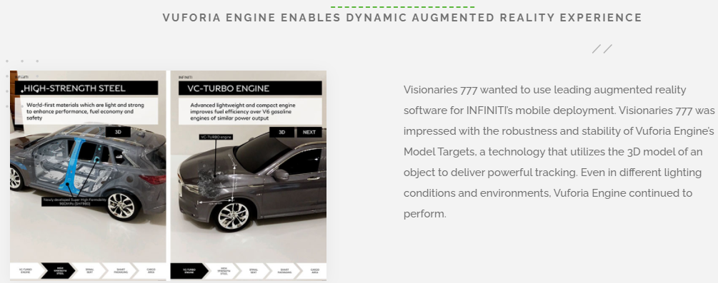
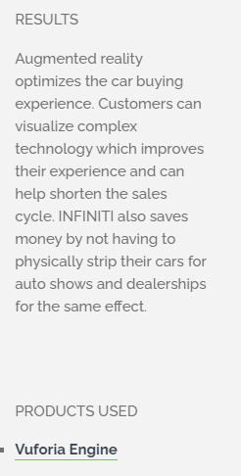
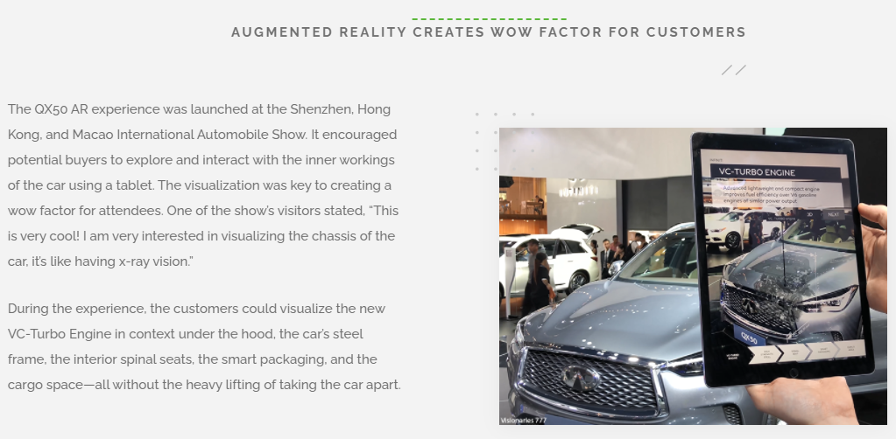

Slide 7

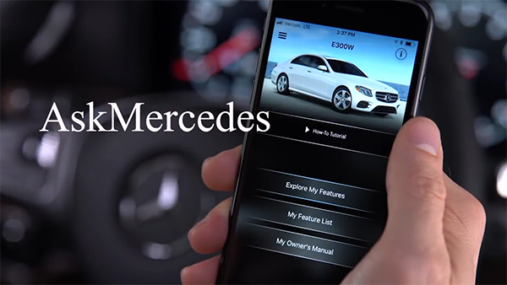
Increase brand value & user experience
Ask Mercedes
Mercedes-Benz’s goal is to increase the brand value and distinguish themselves not only by building very high quality vehicles with advanced features, but also by offering an excellent user experience through all the contact points with the customer.
(Case study)
Watch Full Video
Click Image for Short Video Clip
Notes:
Mercedes-Benz’s goal is to increase the brand value and distinguish themselves not only by building very high quality vehicles with advanced features, but also by offering an excellent user experience through all the contact points with the customer. (model targets were used)

Slide 8
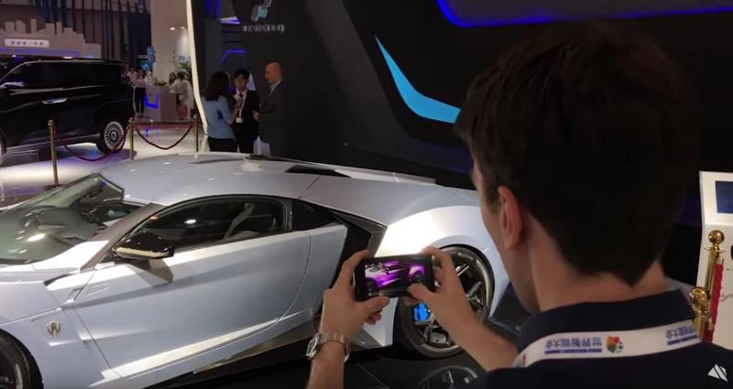

Engaging customer experience & faster sales
Lykan Live Paint
“Vuforia [Engine] has enabled us to take AR beyond a gimmick and create compelling solutions for the enterprise world.”
— Frantz Lasorne, Co-Founder of Visionaries 777
(Case study)
Watch Full Video
Click Image for Short Video Clip
Notes:
This break-through Augmented Reality solution created by Visionaries 777 with the use of Vuforia Engine optimizes dealerships and auto-shows in cost efficient ways by allowing them to demonstrate multiple variations of the same car with just one physical car present. Previously, this would require several cars or pictures, which still wouldn’t capture the true customization. The brand engagement team of W Motors now uses this app to help potential buyers visualize the car in endless design possibilities. (model targets were used)

Slide 9
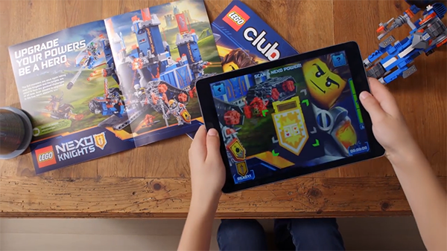

Increase Brand engagement
Lego Nexo Knights
The game received more than 2.7 million downloads in its first 60 days and was the #1 app for kids in the US, UK, Denmark, and Germany. (case study)
Click Image for Short Video Clip
Watch video
Notes:
LEGO has been the iconic building block toy since it was founded in 1932. Nearly 85 years later, many children now learn to use a touchscreen before they learn to read. To evolve with these times, LEGO sought seamless integration between their physical toys and digital play experiences. (VuMarks were used)

Slide 10
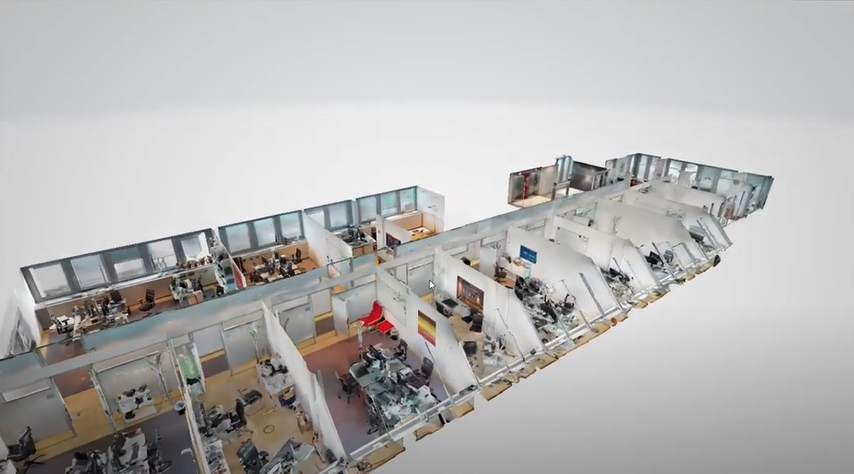
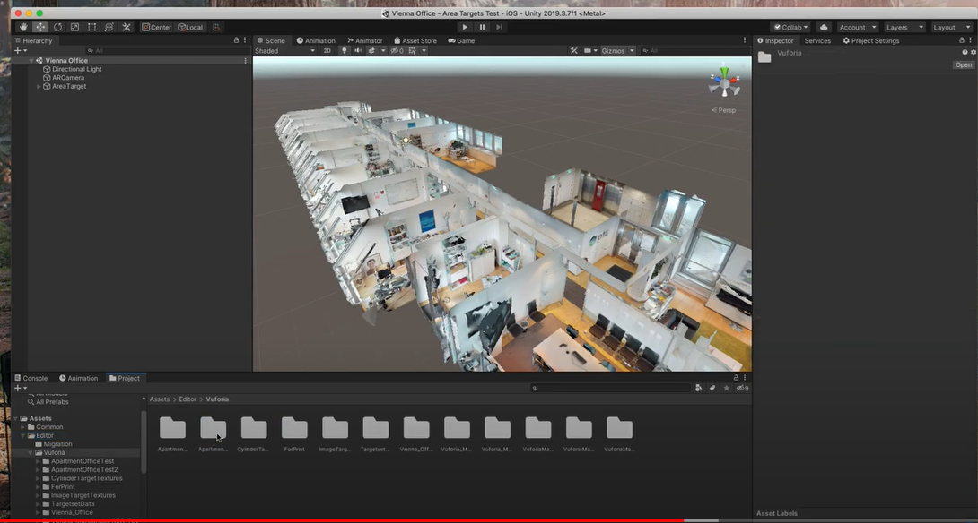
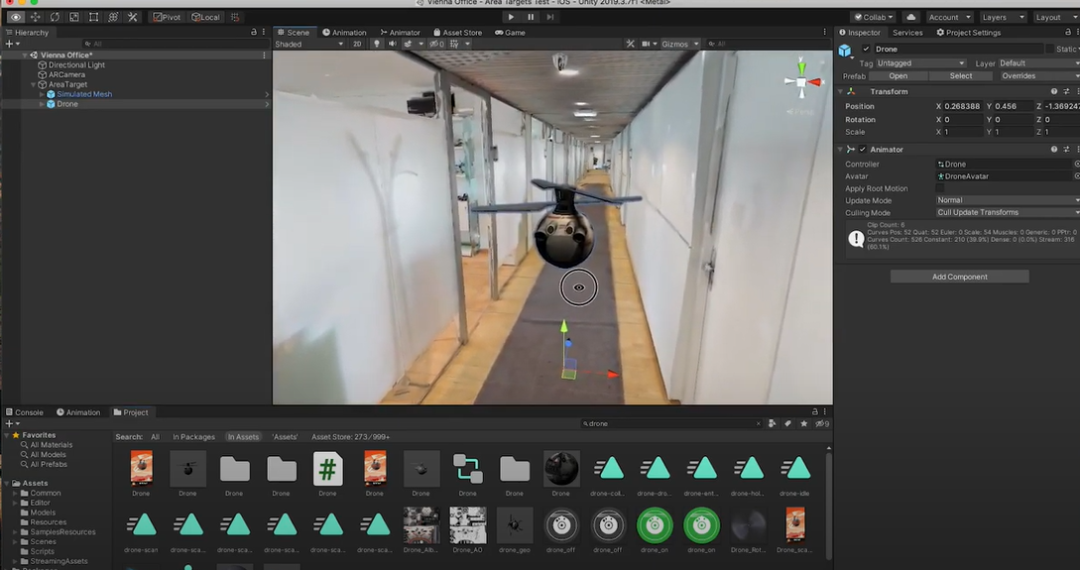
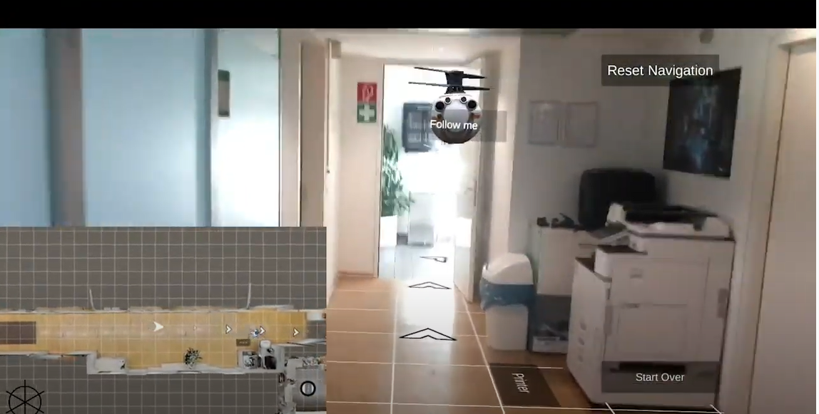
Vuforia +Unity
Notes:
https://www.youtube.com/watch?v=ZY46CWn_4f4

Slide 11
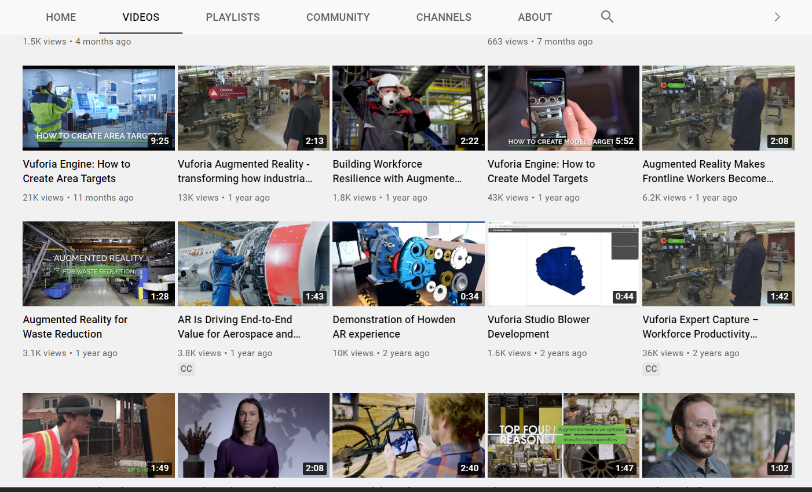
https://www.youtube.com/user/vuforia/videos

Slide 12
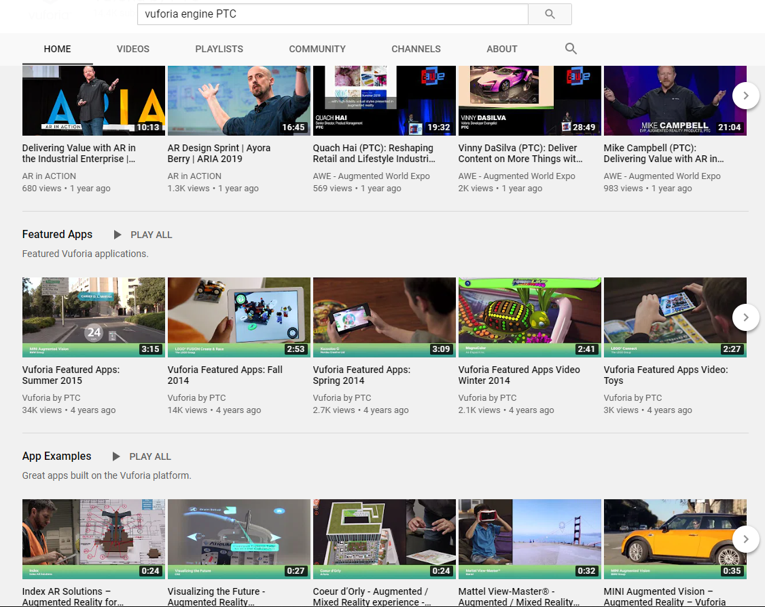
Vuforia engine example on youtube
https://www.youtube.com/user/vuforia

Slide 13
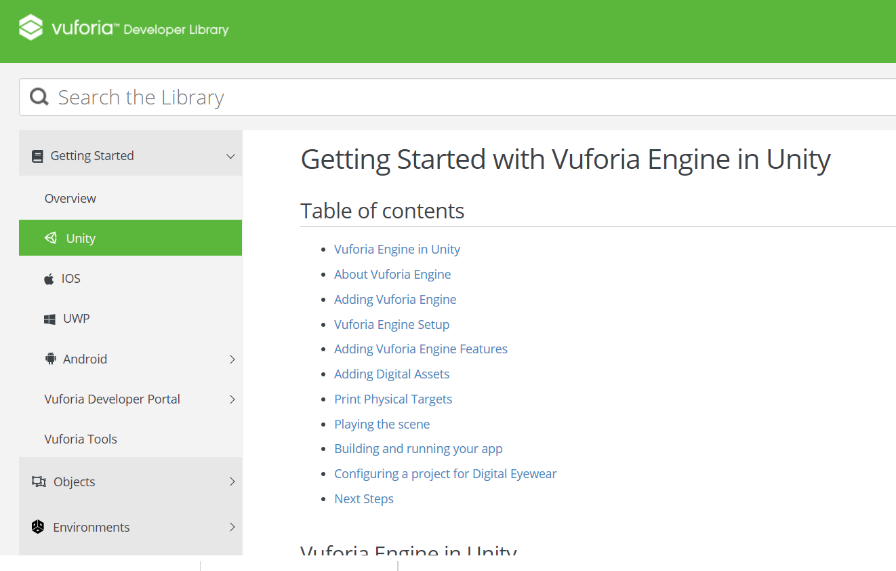
Help Vuforia Engine
https://library.vuforia.com/articles/Training/getting-started-with-vuforia-in-unity.html

